Slide 1
Internship Presentation CSE-498
Minhaz Uddin Ahmed
ID: 082-575-042
Company : GPIT
Advisor: Dr. Shazzad Hosain

Slide 2

GPIT
Grameenphone IT Ltd. is the fastest growing IT Company in Bangladesh which is a 100% subsidiary company of Grameenphone Ltd. started its journey in January 2011. It Provides end to end solutions for Bank, Financial Institute, FMCG, Pharmaceuticals and Telecom Industry
Enterprise Solution Department:
Their task is to Operate, Develop and Implementation of-
Business intelligence
Sales and process automation
Sales reporting
Enterprise portal and automation

Slide 3
Idea Portal and Query Management Application

Slide 4

Idea Portal

Slide 5
Phases of Idea Portal
IDEA
Submission
IDEA
Evaluation
& Feedback
IDEA
Implementation

Slide 6
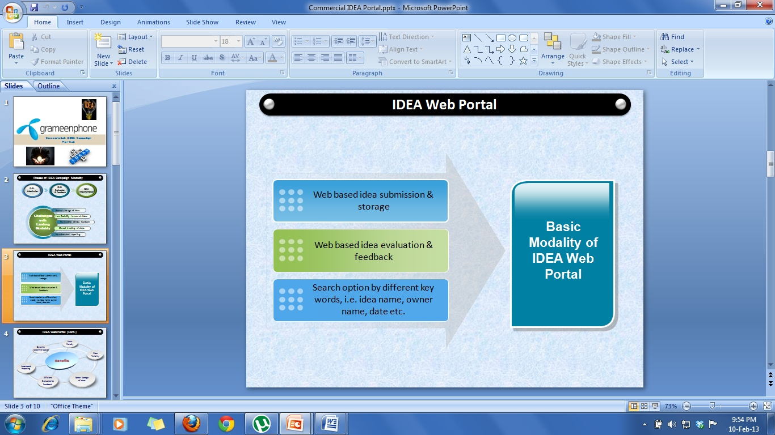
Proposed Model

Slide 7
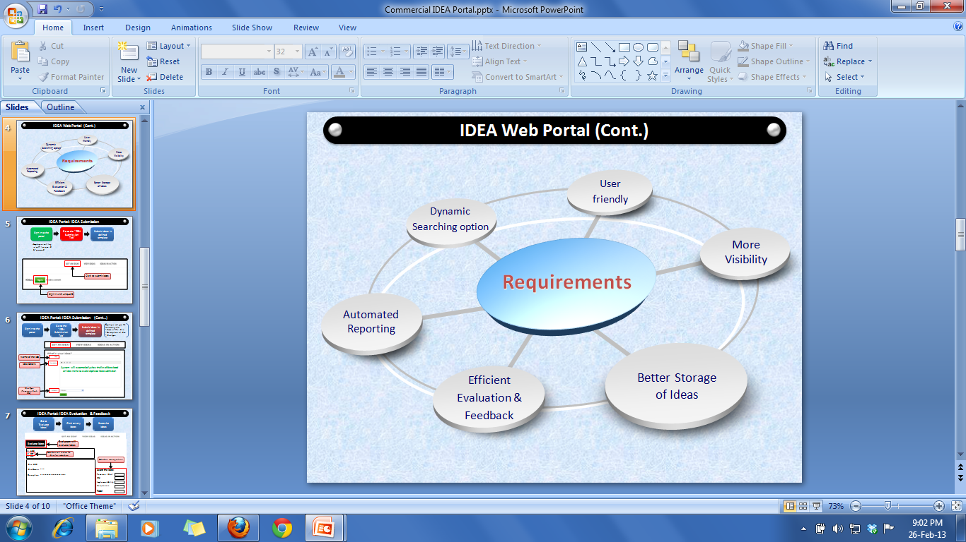
Requirements

Slide 8
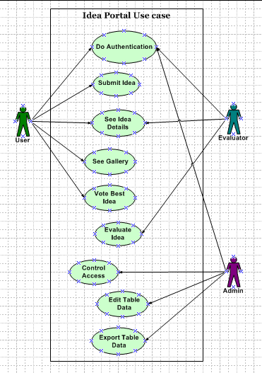
Use Case Diagram

Slide 9
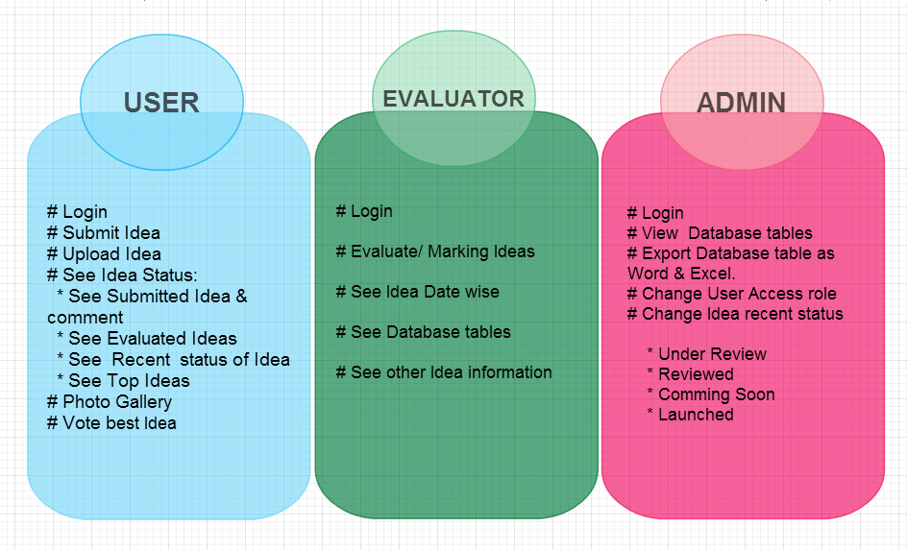
Authentication and Authorization

Slide 10
User
Submit Idea / Upload Idea
See Idea information:
# Submitted Idea and comment
# Evaluated Idea
# Recent status of idea
# Top Idea
………by selecting Idea Category ( P&O, Commercial, CEX, Financial, Technology)
See Photo Gallery
Vote best Ideabaz.

Slide 11
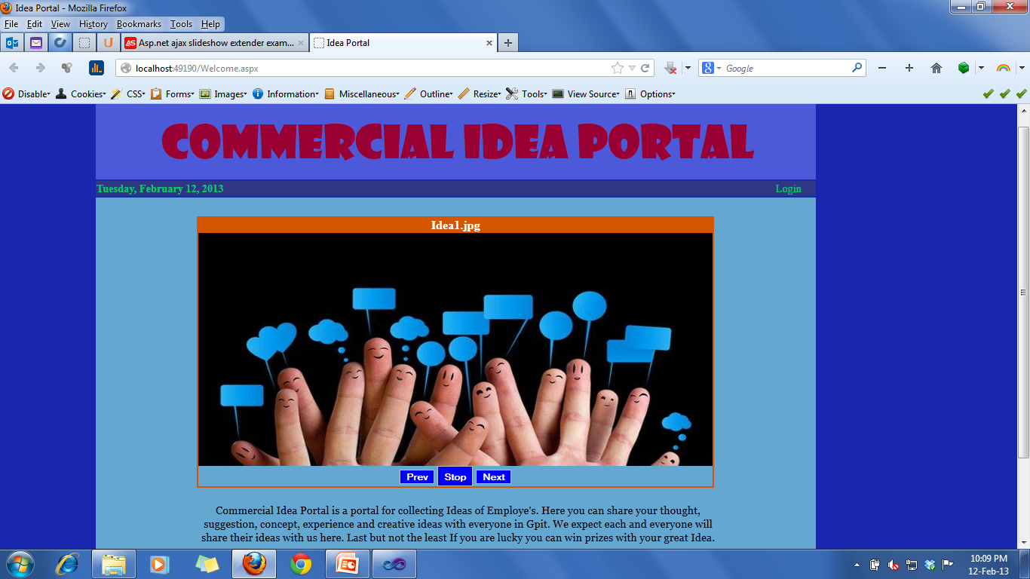
Front Page

Slide 12
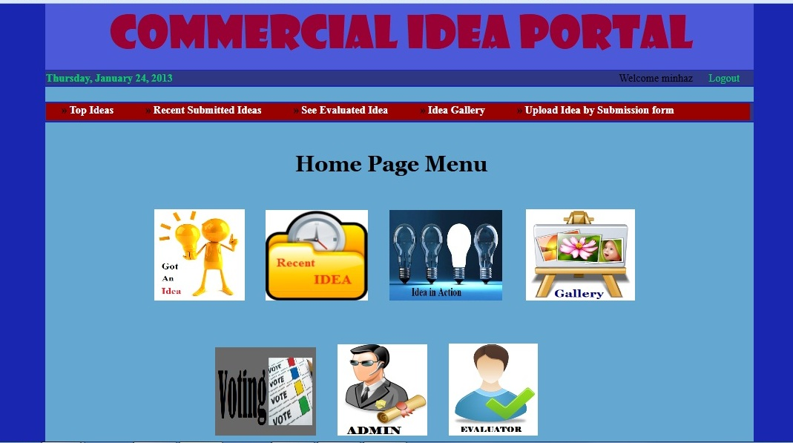
Homepage

Slide 13
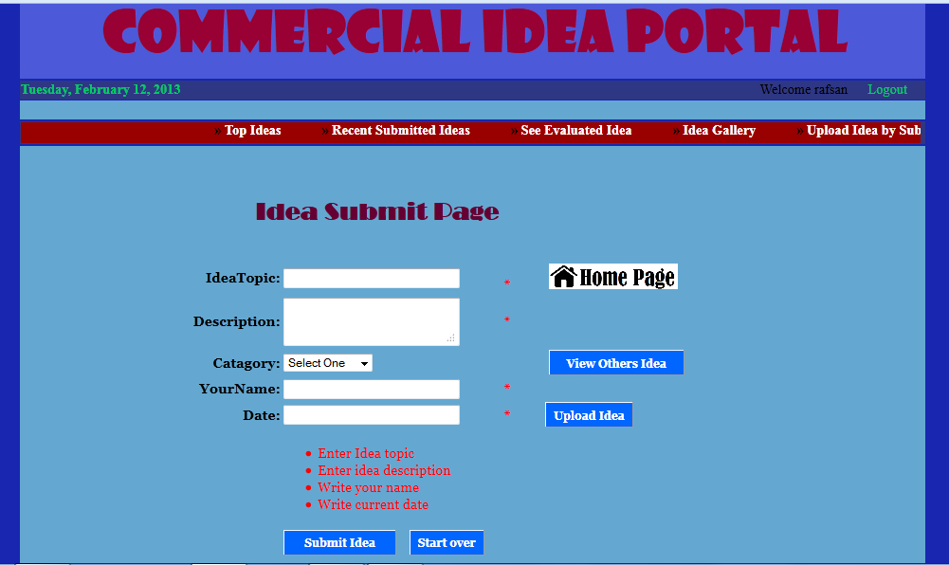
Idea Submit Page

Slide 14
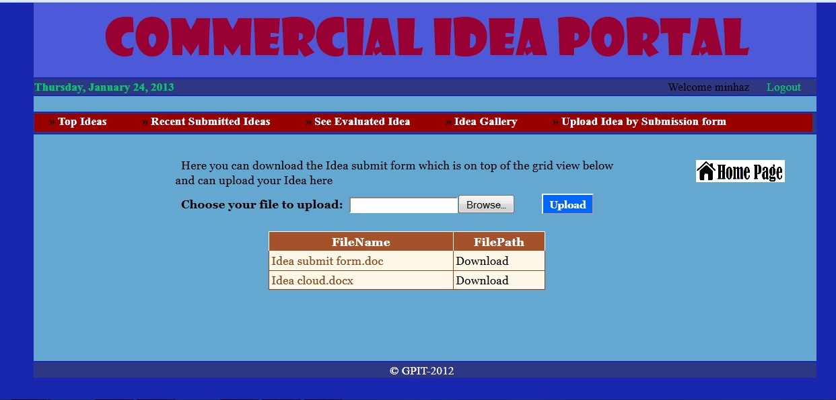
Upload Idea

Slide 15
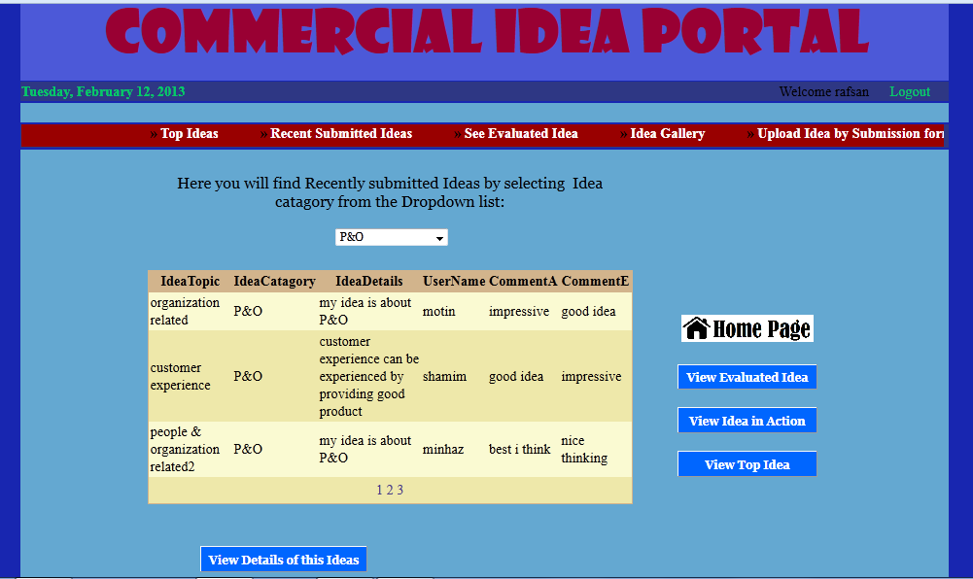
Recent Idea

Slide 16
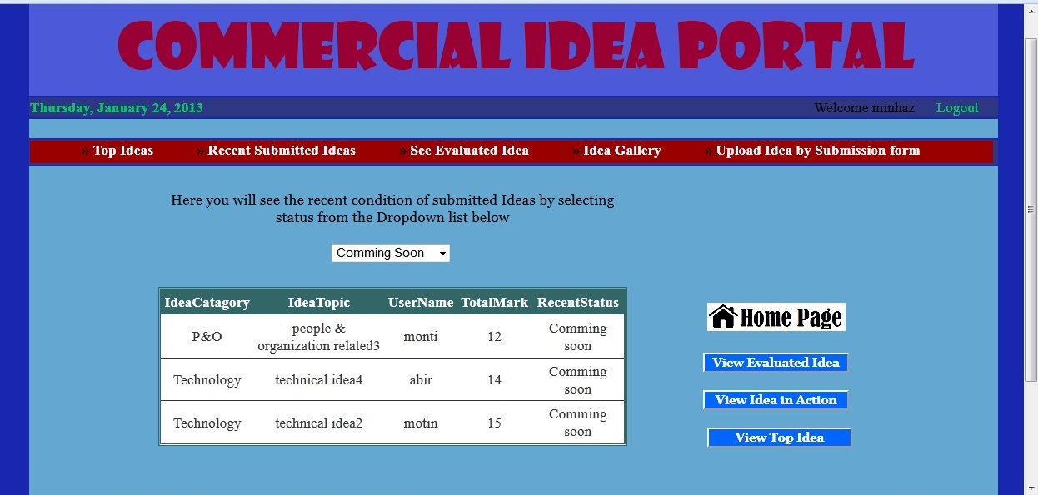
Idea in action

Slide 17
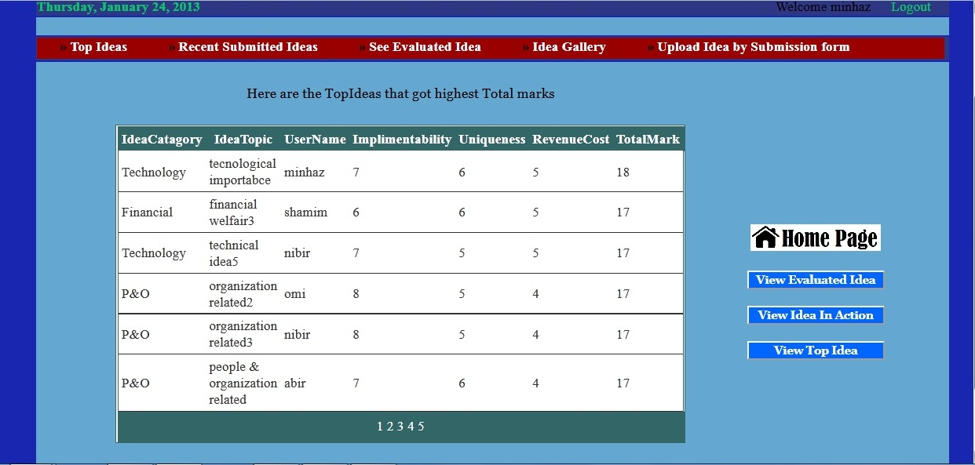
Top Idea

Slide 18
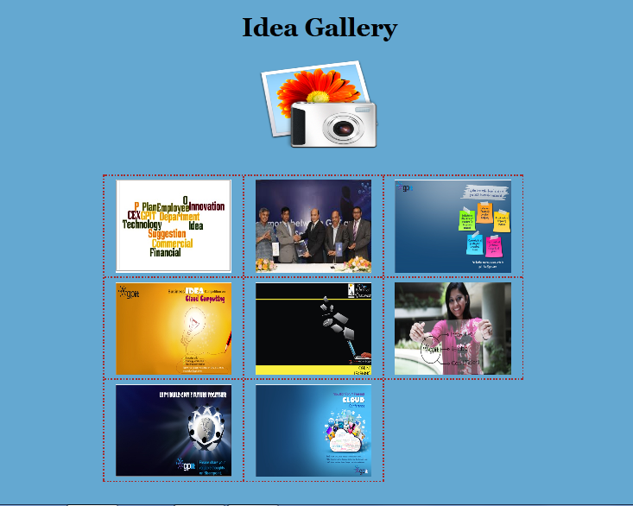
Gallery

Slide 19
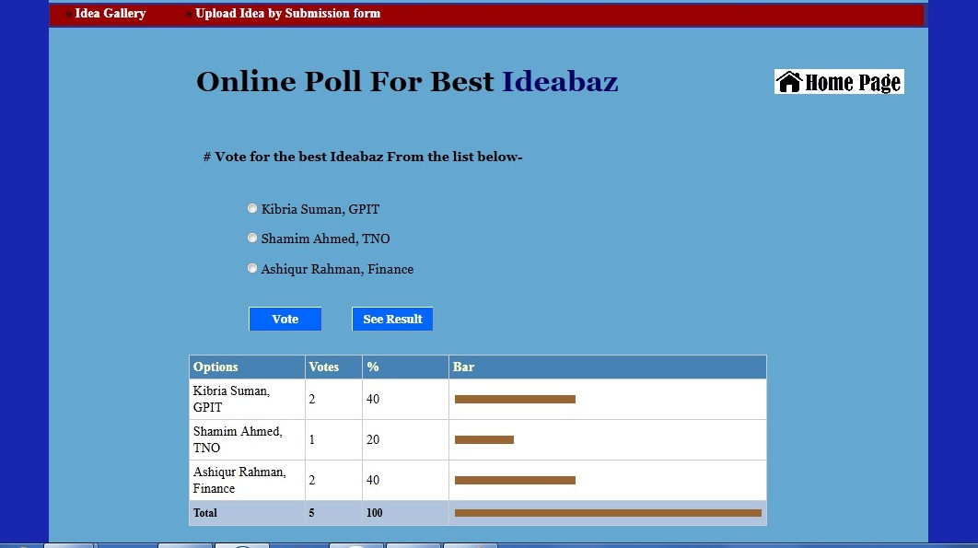
Voting for best Idea

Slide 20
Evaluator
Can Evaluate Idea
See Idea Date wise
See other idea information

Slide 21
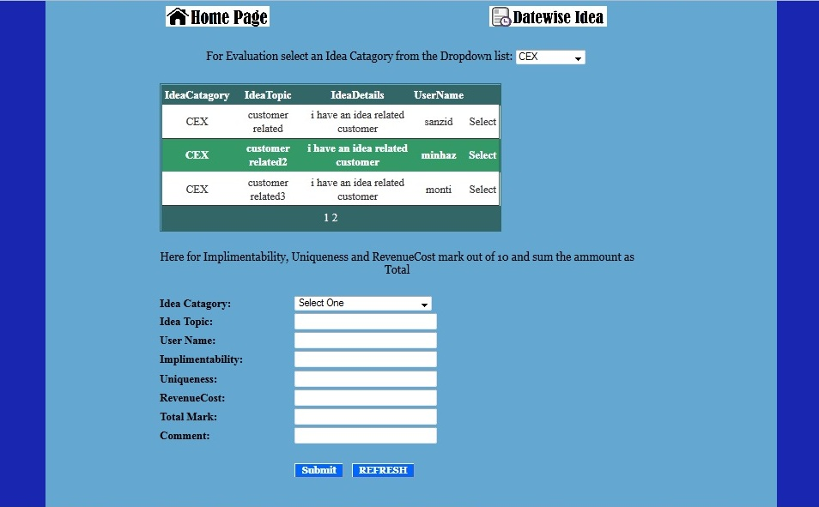
Evaluate Idea Page

Slide 22
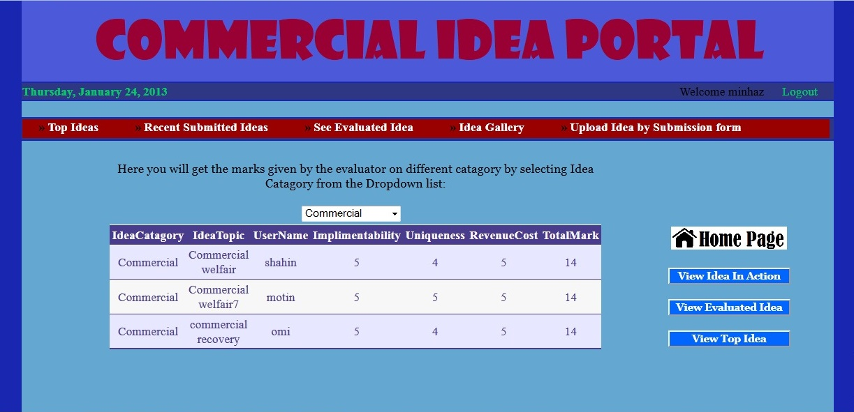
Evaluated Idea

Slide 23
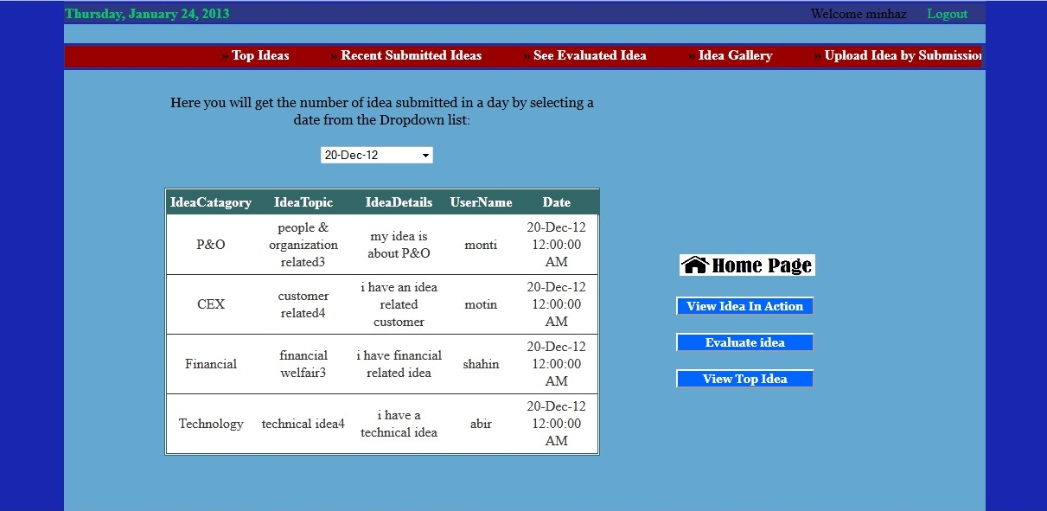
Datewise Submitted Idea

Slide 24
Admin
View All database table
Export database table as Word, Excel.
Change User Access role
Change Idea recent status

Slide 25
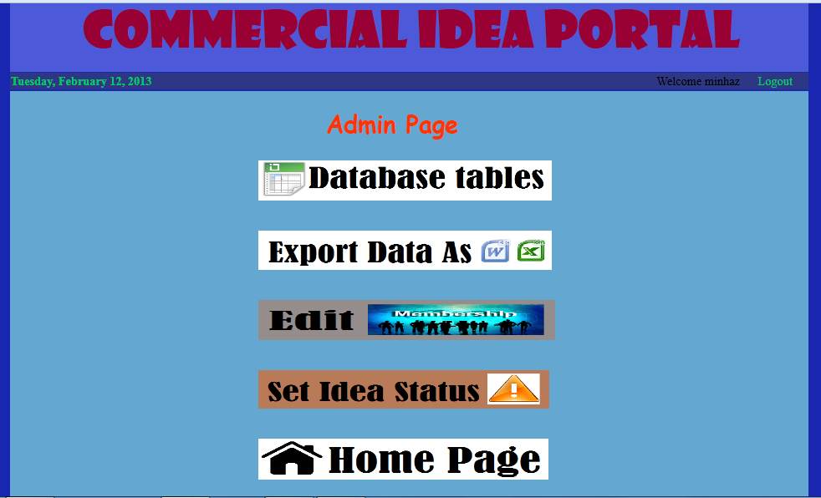
Admin Home Menu

Slide 26
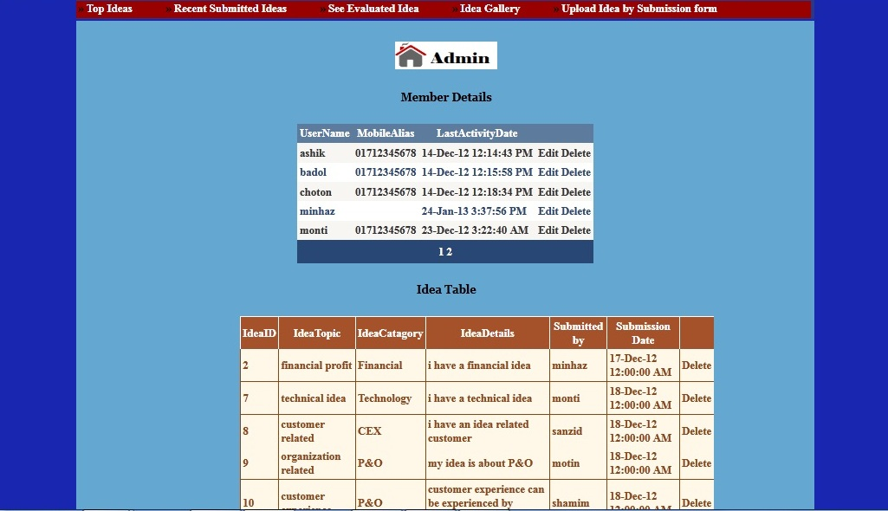
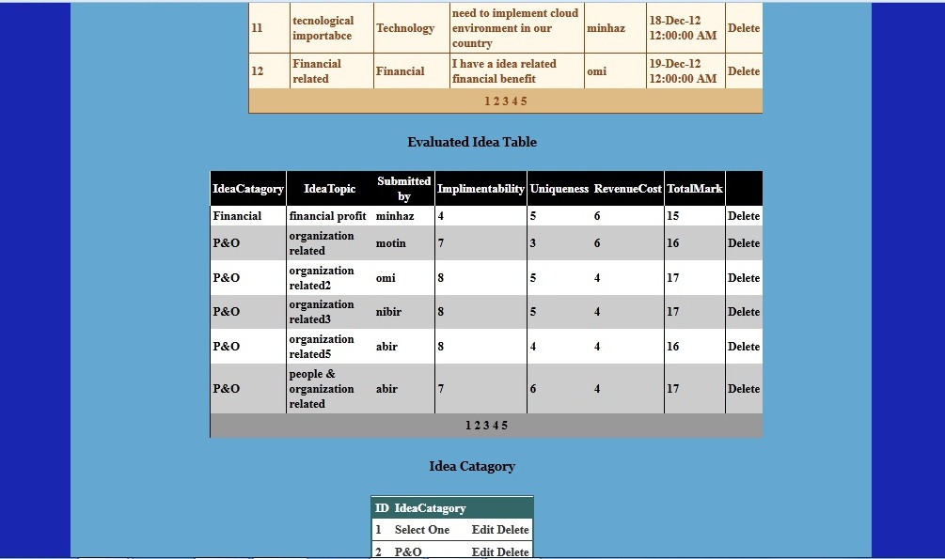
Dtabase tables

Slide 27
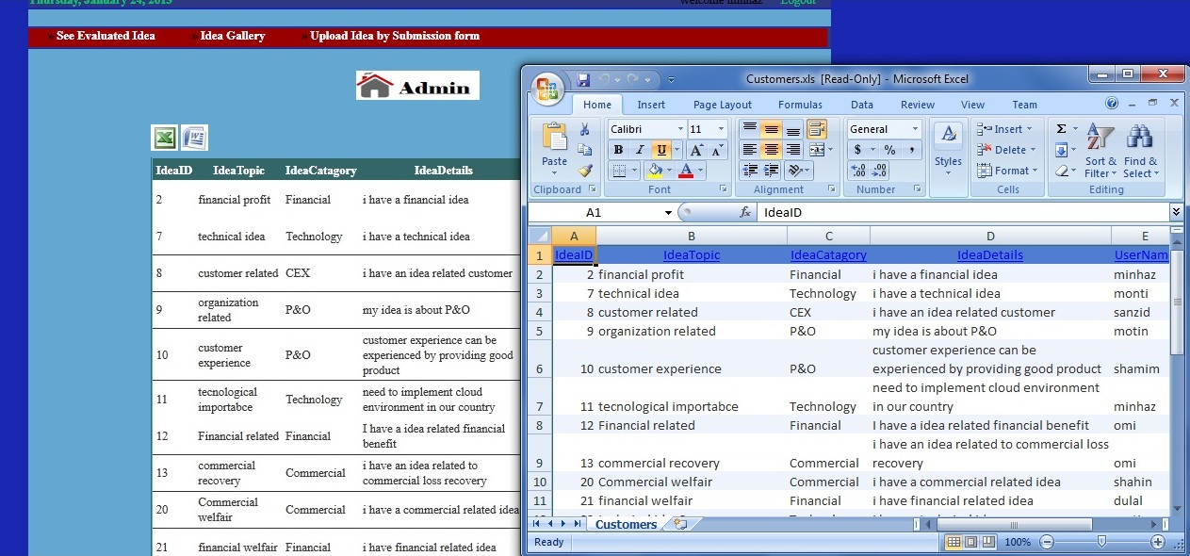
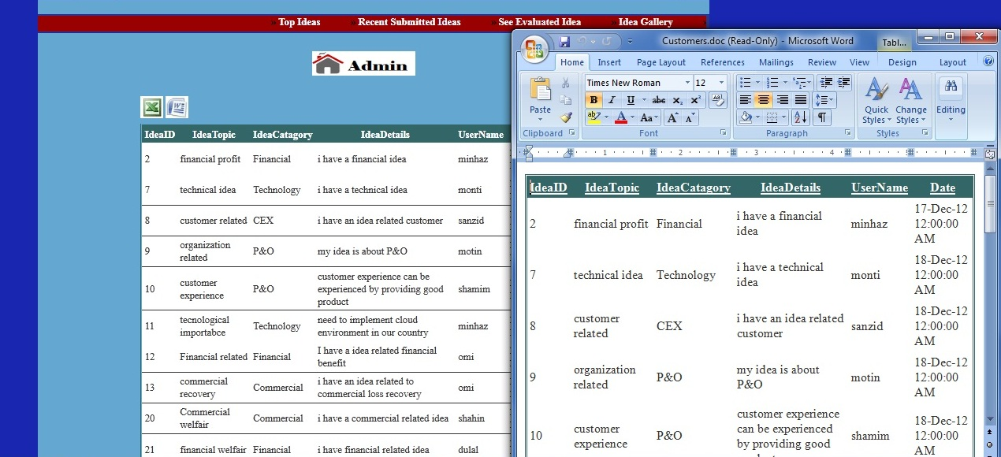
Export Data

Slide 28
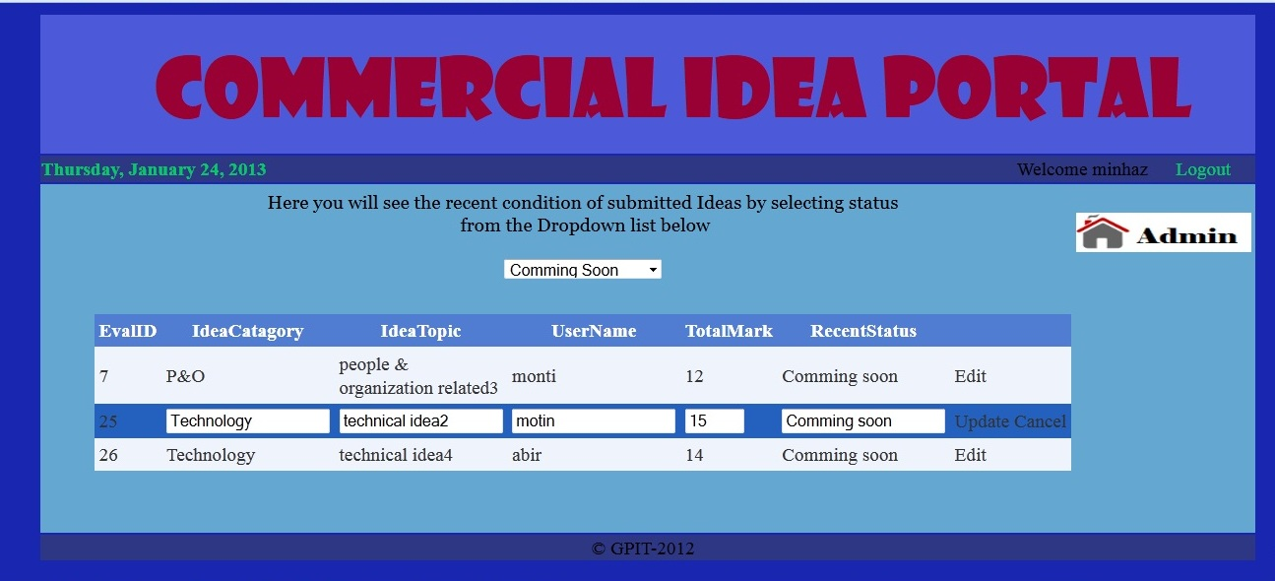
Set Idea Status

Slide 29
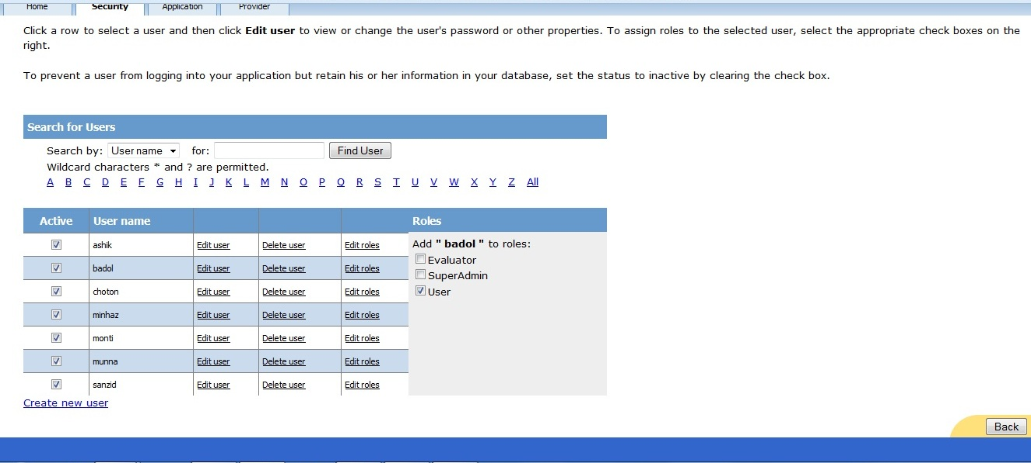
Change Access Role

Slide 30
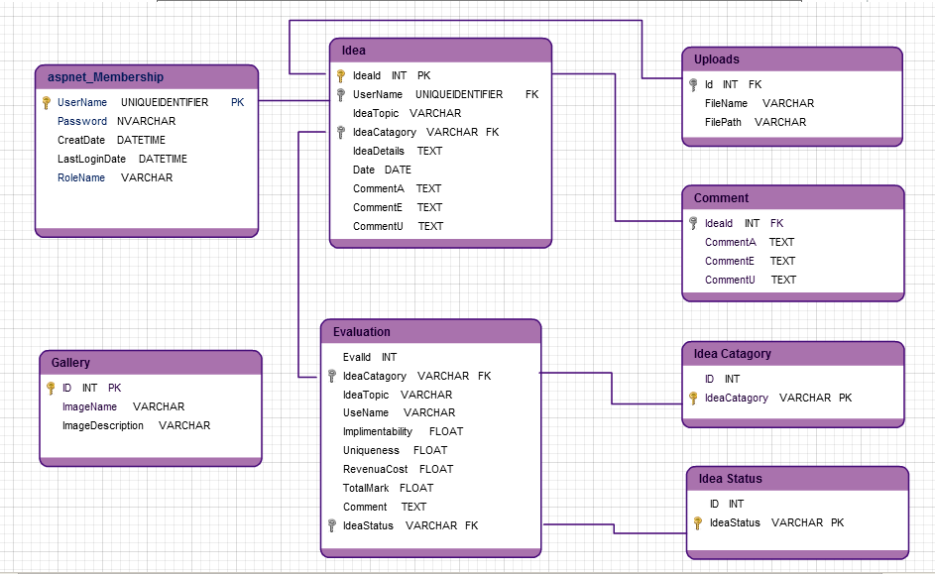
UML Database diagram

Slide 31
Specification
Asp. Net Application
Visual Studio 2010
Asp DOT. Net 4
SQL server 2008
Language- C#, HTML, CSS, JavaScript, JQuery and Ajax

Slide 32

Query Management

Slide 33
Requirements
The Application should be divided into two modules. These are:
1. Customer Module
2. Admin Module
Customer’s Module: The Customer’s Module should be designed to provide the following services:
Posting a Query: Customers should be free to post their queries and the system must identify each query with an automatically generated Id/Password for future references.
Check Status: Customers should be allowed to check the status of their query by using the unique Id provided by the system.
Admin Module: The Admin Module should be designed to provide the following services:
Review and Classification: Admin should review the submitted query, answer them and classify them by Department wise for searching Query Archive.

Slide 34
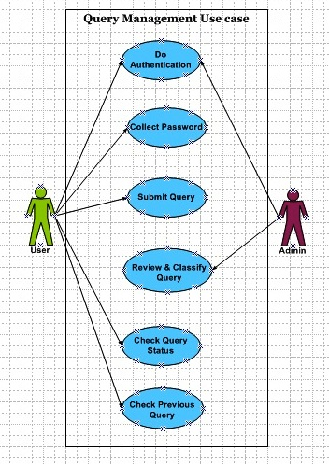
Use case Diagram

Slide 35
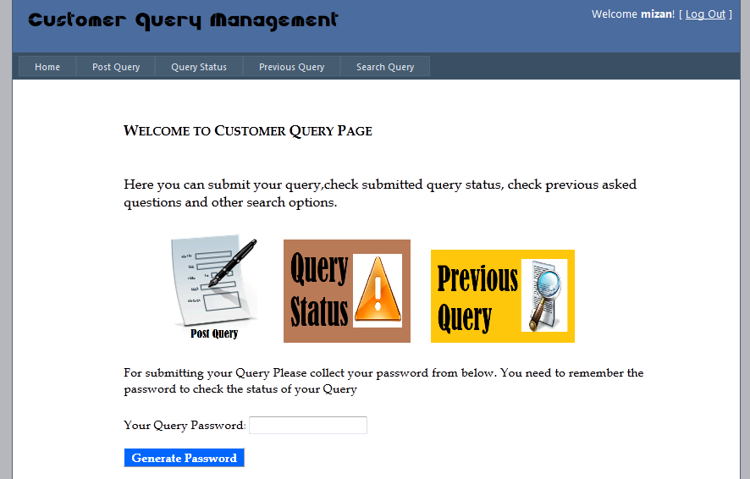
Home Page

Slide 36
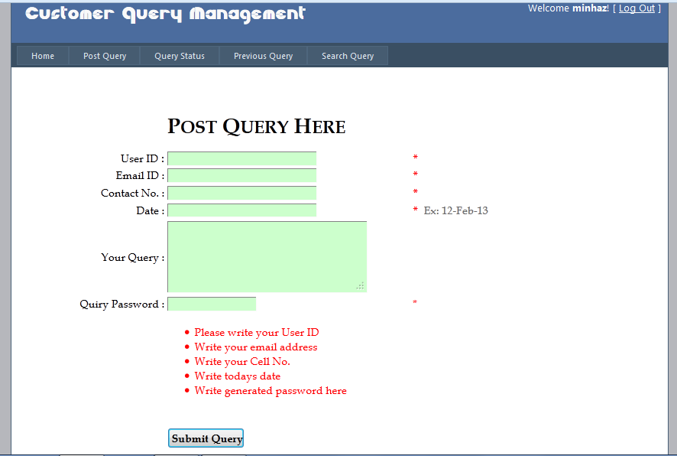
Post Query

Slide 37
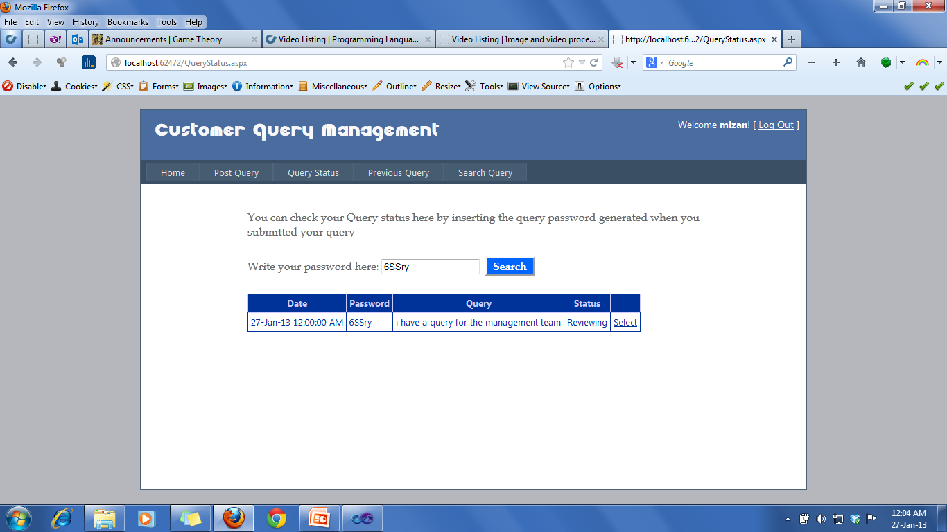
Check Query Status

Slide 38
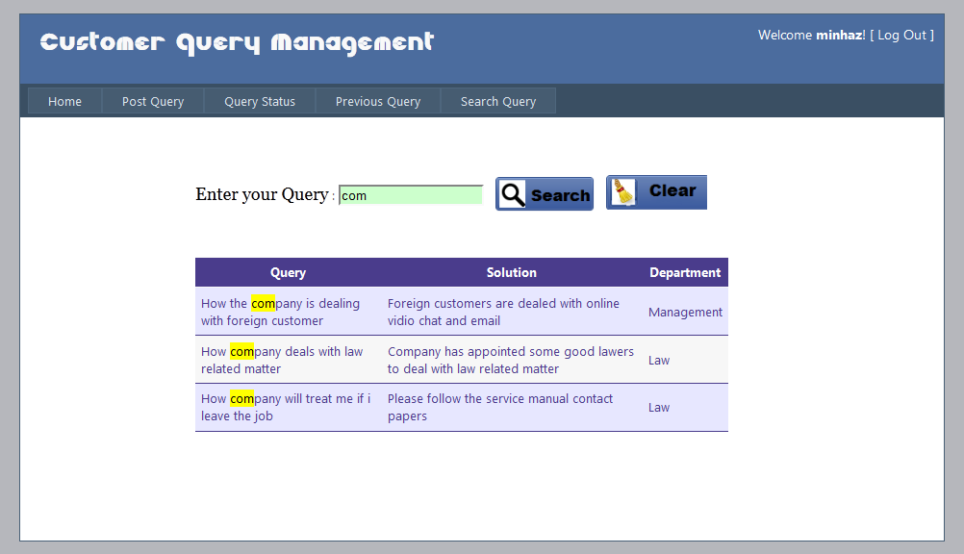
Previous Query

Slide 39
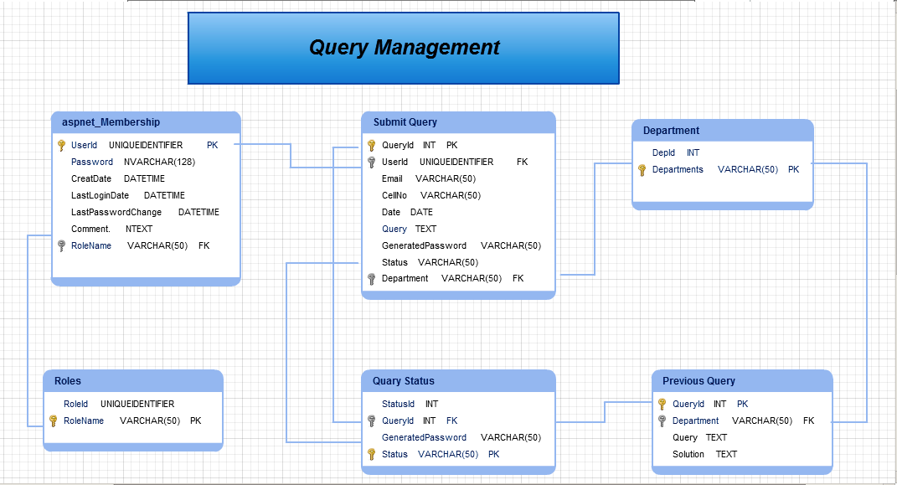
UML Database Diagram

Slide 40
Key Features:
Password Generation
Form validation
More Visual
Search option
Better Storage and management
Secured
Specification:
Asp. Net Web Application using C#, GRID View highlight and Password generation function.

Slide 41
Thanks All

